Slide 1

50.051 Programming Language Concepts W11-S2 (Bonus) Intermediate Code Generation
Matthieu De Mari

Slide 2
Code is legal!
Definition (Legal Code):
A legal code is a program that adheres to all the rules of a programming language. It passed through various stages, including:
Lexical Analysis
Syntax Analysis
Semantic Analysis
Property: A code is considered legal if it satisfies the requirements of lexical analysis, syntax analysis, semantic analysis.
A code that is deemed legal should be able to run correctly, after it has been transformed into machine code.

Slide 3
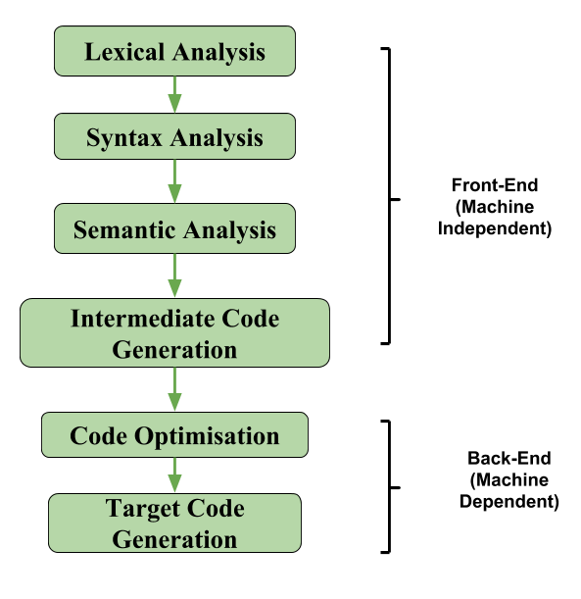
The middle-end of a compiler
Definition (The middle-end part of a compiler):
The middle-end of a compiler follows the front-end analysis and it consists of a series of operations and transformations to optimize and improve its efficiency.
It involves tasks, such as:
Intermediate code generation
Code optimization,
and Data-flow analysis.

Slide 4
Intermediate code generation
Definition (Intermediate code generation):
Intermediate code generation is the process of transforming the source code into a code that is more abstract and closer to machine language.
Making a direct jump from source code to target code might prove difficult.
Intermediate code
Source code
Target code

Slide 5
Intermediate code generation
Definition (Intermediate code generation):
Intermediate code generation is the process of transforming the source code into a code that is more abstract and closer to machine language.
Making a direct jump from source code to target code might prove difficult.
For this reason, an intermediate code representation is often easier to manipulate and allows for optimization.
The intermediate code is not specific to any particular hardware or operating system and can be easily transformed into the final machine code (Intermediate code is roughly a high-level assembly code?).

Slide 6
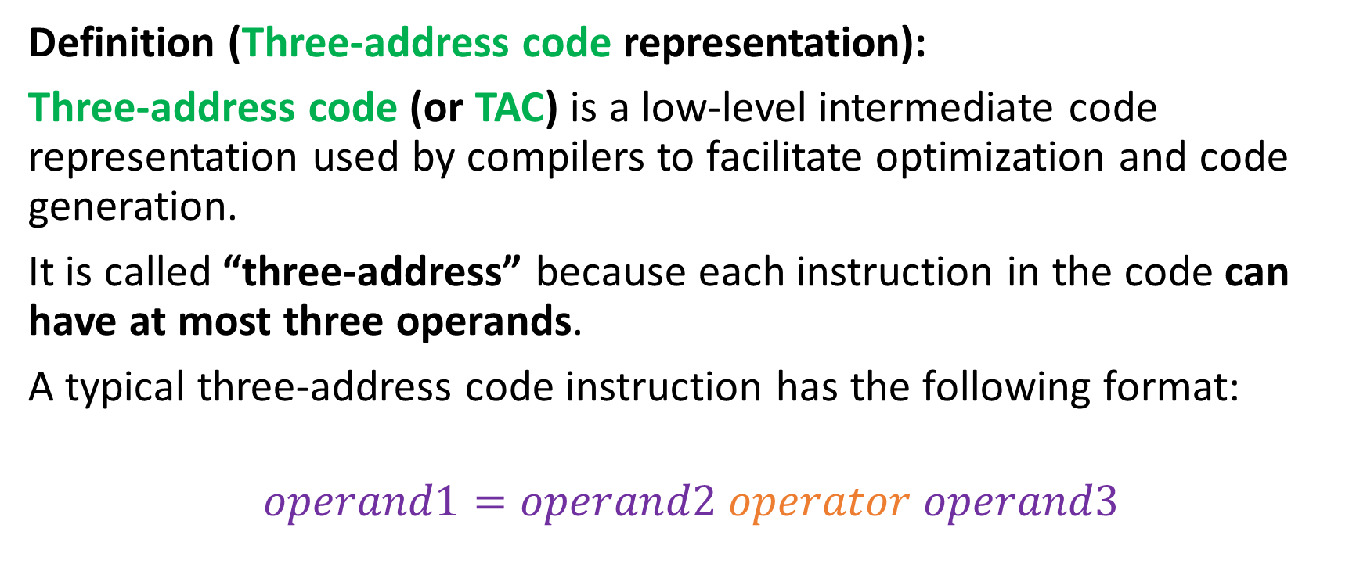
Three-address code representation
Definition (Three-address code representation):
Three-address code (or TAC) is a low-level intermediate code representation used by compilers to facilitate optimization and code generation.
It is called “three-address” because each instruction in the code can have at most three operands.
A typical three-address code instruction has the following format:
$$operand1=operand2 operator operand3$$

Slide 7
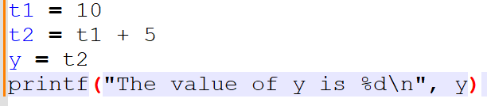
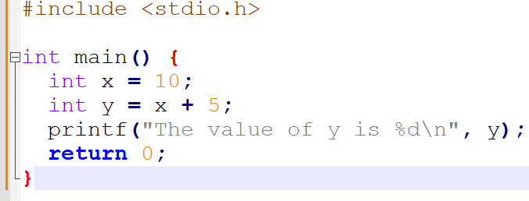
Three-address code representation
For instance, the C code below can be transformed…
…into its equivalent three-address code representation.

Slide 8
Overview
Our plan for today!
Introduction to TAC.
TAC for simple expressions.
TAC for functions and function calls.
TAC for objects.
TAC for arrays.
Generating TAC.
A few low-level details.

Slide 9
A quick note before we start
An important note before we start
When generating IR at this level, you do not need to worry about optimizing it.
It is okay to generate IR that has lots of unnecessary assignments, redundant computations, uses many temporary variables, etc.
In the next lecture, we will discuss how to optimize IR code.
Optimization is tricky, but interesting!

Slide 10

CFG for TAC
Technically, the three-address code has a syntax and CFG of its own.
P → SP | $ε$
S → id := id op id
S → id := op id
S → id := id
S → push id
S → if id goto L
S → L:
S → jump L
id → (any identifier name)
id → (any constant literal)
op → (any basic operator e.g. +, -, *, /, ==, <, ||, &&, etc. )
L → L0 | L1 | … (block name)
Normally, many more production rules for S…

Slide 11
Basic block in TAC
Definition (basic block in TAC):
A basic block consists of a sequence of instructions in TAC, with:
No labels (except at the first instruction),
No jumps (except at the last instruction of the block).
Core idea behind basic blocks:
Cannot jump in the middle of a basic block, only the beginning,
Cannot jump out of a block, except at the end of it,
Basic block is then a single-entry and single-exit code segment.

Slide 12
Basic block in TAC
A basic block always writes as:
Start with a block name, by convention, in the form of Ln, with n an integer.
Has elementary operations in TAC format.
Could have conditional structures, using if.
Goto/jump could reference current block or another block.
For instance
L1:
w := x - 1
z := w > 0
if z goto L1
jump L2

Slide 13
Basic block in TAC
Question: Which C code could have potentially generated this TAC?
For instance
L1:
w := x - 1
z := w > 0
if z goto L1
jump L2

Slide 14
Basic block in TAC
Question: Which C code could have potentially generated this TAC?
int x = 4;
… (Some code L0)
do {
x = x - 1
} while (x > 0)
… (Some more code in L2)
For instance
L1:
w := x - 1
z := w > 0
if z goto L1
jump L2

Slide 15
Control flow graph
L0:
x := 1
i := 1
L1:
x := x*x
i := i+1
if i < 10 goto L1
jump L2
L2:
y := 10
Definition (control-flow graph):
A control-flow graph is a directed graph with basic blocks as nodes, and an edge from block A to block B if the execution can pass from the last instruction in A to the first instruction in B.
E.g., the last instruction in A is jump LB
E.g., execution can fall-through from block A to block B

Slide 16
TAC for simple expressions
C code
int a;
int b;
a = 3
b = 1
c = 5 + 2*b
d = a*a + b*c
TAC code
_t0 := 3
_t1 := 1
_t2 := 2 * _t1
_t3 := 5 + _t2
_t4 = _t0 * _t0
_t5 = _t1 * _t3
_t6 = _t4 + _t5

Slide 17
TAC for simple expressions
Observations
The “three” in “three-address code” refers to the upmost number of operands in any instruction.
Could technically have instructions with only two operands.
Evaluating an expression with more than three subexpressions requires the introduction of temporary variables.
Question: who holds the key to how to deconstruct a long mathematical expression into smaller three-operands expressions with the right precedence order?

Slide 18
TAC for simple expressions
Observations
The “three” in “three-address code” refers to the upmost number of operands in any instruction.
Could technically have instructions with only two operands.
Evaluating an expression with more than three subexpressions requires the introduction of temporary variables.
Question: who holds the key to how to deconstruct a long mathematical expression into smaller three-operands expressions with the right precedence order?
Answer: Your parse tree/abstract syntax tree from earlier!

Slide 19
TAC for simple expressions
c
C code
int a;
int b;
a = 3
b = 1
c = 5 + 2*b
d = a*a + b*c
SDT for +: result.val = e1.val + e2.val
+
SDT for *: result.val = e1.val * e2.val
5
*
2
b
SDT for b: b.val = 1.val
1

Slide 20
TAC for simple expressions
c
Your final translation is in the abstract syntax tree from earlier!
Remember, we have an AST,
Annotated with elementary operations (syntax analysis),
Annotated with scope information (semantic analysis),
And annotated with type information (semantic analysis).
SDT for +: result.val = e1.val + e2.val
+
SDT for *: result.val = e1.val * e2.val
5
*
2
b
SDT for b: b.val = 1.val
1

Slide 21
TAC for simple expressions
c
Collecting each of the SDT instructions in the AST using our recursive descent tree algorithm/DFS gives…
b.val = 1.val
result.val = e1.val * e2.val
result.val = e1.val + e2.val
SDT for +: result+.val = e1.val + e2.val
+
SDT for *: result*.val = e1.val * e2.val
5
*
2
b
SDT for b: b.val = 1.val
1

Slide 22
TAC for simple expressions
c
Using _tx notations in order to disambiguate and recognizing connections…
_t0.val = 1.val
_t1.val = 2.val * _t0.val
_t2.val = 5.val + _t1.val
SDT for +: result+.val = e1.val + e2.val
+
SDT for *: result*.val = e1.val * e2.val
5
*
2
b
SDT for b: b.val = 1.val
1

Slide 23
TAC for simple expressions
c
Finally, recognizing that constant.val = constant (e.g. 5.val = 5)
_t0.val = 1
_t1.val = 2 * _t0.val
_t2.val = 5 + _t1.val
SDT for +: result+.val = e1.val + e2.val
+
SDT for *: result*.val = e1.val * e2.val
5
*
2
b
SDT for b: b.val = 1.val
1

Slide 24
TAC for simple expressions
c
Repeat for the AST computing the value of d and chain instructions together!
_t0.val = 1
_t1.val = 2 * _t0.val
_t2.val = 5 + _t1.val
SDT for +: result+.val = e1.val + e2.val
+
SDT for *: result*.val = e1.val * e2.val
5
*
2
b
SDT for b: b.val = 1.val
1

Slide 25
TAC generation for SDT expressions
Our SDT expressions are quite close to the TAC expressions already.
All we need is
A mapping to translate our SDT elementary operations into their TAC equivalents (SDT: e.val = a.val + b.val → TAC: e:= a + b).
A function that will correctly link variables using the edges of our abstract syntax tree (easily done).
A function that will open registers _tn and keep a counter on n.
Could be easily implemented (but would require an implementation of an abstract syntax tree object during parsing, which we did not do!).

Slide 26
TAC generation for SDT expressions
Core idea for implementation: define a code generation, or cgen() function, whose behaviour is described below in a few scenarios.
cgen(k) = { // here k refers to a constant literal
Choose a new temporary _tn using our counter n;
Increment n by 1;
Emit ( _tn = k );
Return _tn;
}

Slide 27
TAC generation for SDT expressions
Core idea for implementation: define a code generation, or cgen() function, whose behaviour is described below in a few scenarios.
cgen(id) = { // here id refers to an identifier (could be a _tn)
Choose a new temporary _tn using our counter n;
Increment n by 1;
Emit ( _tn = id );
Return _tn;
}

Slide 28
TAC generation for SDT expressions
Core idea for implementation: define a code generation, or cgen() function, whose behaviour is described below in a few scenarios.
cgen(id = k) = { // here id refers to an identifier (could be a _tn)
// and k refers to a constant literal.
Emit (id = k);
Return null;
}

Slide 29
TAC generation for SDT expressions
Core idea for implementation: define a code generation, or cgen() function, whose behaviour is described below in a few scenarios.
cgen(e1 + e2) = {
Choose three new temporary t using our counter n (we shall name them as _tn, _t(n+1), _t(n+2));
Increment n by 3;
Let _tn = cgen(e1);
Let _t(n+1) = cgen(e2);
Emit (_t(n+2) = _tn + _t(n+1));
Return _t(n+2);
}

Slide 30
TAC generation for SDT expressions
For instance, let us assume we have the expression 5 + x and n = 0.
cgen(e1 + e2) = {
Choose three new temporary t using our counter n (we shall name them as _tn, _t(n+1), _t(n+2));
Increment n by 3;
Let _tn = cgen(e1);
Let _t(n+1) = cgen(e2);
Emit (_t(n+2) = _tn + _t(n+1));
Return _t(n+2);
}

Slide 31
TAC generation for SDT expressions
For instance, let us assume we have the expression 5 + x and n = 0.
cgen(5 + x) = {
Choose three new temporary t using our counter n (we shall name them as _tn, _t(n+1), _t(n+2));
Increment n by 3;
Let _tn = cgen(5);
Let _t(n+1) = cgen(x);
Emit (_t(n+2) = _tn + _t(n+1));
Return _t(n+2);
}

Slide 32
TAC generation for SDT expressions
For instance, let us assume we have the expression 5 + x and n = 0.
cgen(5 + x) = {
Choose three new temporary t using our counter n (we shall name them as _t0, _t1, _t2);
Increment n by 3;
Let _t0 = cgen(5);
Let _t1 = cgen(x);
Emit (_t2 = _t0 + _t1);
Return _t2;
}

Slide 33
TAC generation for SDT expressions
For instance, let us assume we have the expression 5 + x and n = 3.
cgen(5 + x) = {
Choose three new temporary t using our counter n (we shall name them as _t0, _t1, _t2);
Increment n by 3;
Let _t0 = cgen(5);
Let _t1 = cgen(x);
Emit (_t2 = _t0 + _t1);
Return _t2;
}

Slide 34
TAC generation for SDT expressions
For instance, let us assume we have the expression 5 + x and n = 3.
cgen(5 + x) = {
Choose three new temporary t using our counter n (we shall name them as _t0, _t1, _t2);
Increment n by 3;
Let _t0 = cgen(5);
Let _t1 = cgen(x);
Emit (_t2 = _t0 + _t1);
Return _t2;
}
cgen(5) = {
Choose a new temporary _tn using our counter n;
Increment n by 1;
Emit ( _tn = k );
Return _tn;
}

Slide 35
TAC generation for SDT expressions
For instance, let us assume we have the expression 5 + x and n = 4.
cgen(5 + x) = {
Choose three new temporary t using our counter n (we shall name them as _t0, _t1, _t2);
Increment n by 3;
Let _t0 = cgen(5);
Let _t1 = cgen(x);
Emit (_t2 = _t0 + _t1);
Return _t2;
}
cgen(5) = {
Choose _t4
Increment n by 1;
Emit ( _tn = k );
Return _tn;
}

Slide 36
TAC generation for SDT expressions
For instance, let us assume we have the expression 5 + x and n = 4.
cgen(5 + x) = {
Choose three new temporary t using our counter n (we shall name them as _t0, _t1, _t2);
Increment n by 3;
Let _t0 = cgen(5);
Let _t1 = cgen(x);
Emit (_t2 = _t0 + _t1);
Return _t2;
}
TAC code
_t4 := 5
cgen(5) = {
Choose _t4
Increment n by 1;
Emit ( _t4 = 5 );
Return _t4;
}

Slide 37
TAC generation for SDT expressions
For instance, let us assume we have the expression 5 + x and n = 4.
cgen(5 + x) = {
Choose three new temporary t using our counter n (we shall name them as _t0, _t1, _t2);
Increment n by 3;
Let _t0 = cgen(5);
Let _t1 = cgen(x);
Emit (_t2 = _t0 + _t1);
Return _t2;
}
TAC code
_t4 := 5
_t0 := _t4
cgen(5) = {
Choose _t4
Increment n by 1;
Emit ( _t4 = 5 );
Return _t4;
}

Slide 38
TAC generation for SDT expressions
For instance, let us assume we have the expression 5 + x and n = 3.
cgen(5 + x) = {
Choose three new temporary t using our counter n (we shall name them as _t0, _t1, _t2);
Increment n by 3;
Let _t0 = cgen(5);
Let _t1 = cgen(x);
Emit (_t2 = _t0 + _t1);
Return _t2;
}
cgen(id) = {
Choose a new temporary _tn using our counter n;
Increment n by 1;
Emit ( _tn = id );
Return _tn;
}

Slide 39
TAC generation for SDT expressions
For instance, let us assume we have the expression 5 + x and n = 5.
cgen(5 + x) = {
Choose three new temporary t using our counter n (we shall name them as _t0, _t1, _t2);
Increment n by 3;
Let _t0 = cgen(5);
Let _t1 = cgen(x);
Emit (_t2 = _t0 + _t1);
Return _t2;
}
TAC code
_t4 := 5
_t0 := _t4
cgen(x) = {
Choose _t5
Increment n by 1;
Emit ( _tn = id );
Return _tn;
}

Slide 40
TAC generation for SDT expressions
For instance, let us assume we have the expression 5 + x and n = 4.
cgen(5 + x) = {
Choose three new temporary t using our counter n (we shall name them as _t0, _t1, _t2);
Increment n by 3;
Let _t0 = cgen(5);
Let _t1 = cgen(x);
Emit (_t2 = _t0 + _t1);
Return _t2;
}
TAC code
_t4 := 5
_t0 := _t4
_t5 := x
cgen(x) = {
Choose _t5
Increment n by 1;
Emit ( _t5 = x );
Return _tn;
}

Slide 41
TAC generation for SDT expressions
For instance, let us assume we have the expression 5 + x and n = 4.
cgen(5 + x) = {
Choose three new temporary t using our counter n (we shall name them as _t0, _t1, _t2);
Increment n by 3;
Let _t0 = cgen(5);
Let _t1 = cgen(x);
Emit (_t2 = _t0 + _t1);
Return _t2;
}
TAC code
_t4 := 5
_t0 := _t4
_t5 := x
_t1 := _t5
cgen(x) = {
Choose _t5
Increment n by 1;
Emit ( _t5 = x );
Return _t5;
}

Slide 42
TAC generation for SDT expressions
For instance, let us assume we have the expression 5 + x and n = 4.
cgen(5 + x) = {
Choose three new temporary t using our counter n (we shall name them as _t0, _t1, _t2);
Increment n by 3;
Let _t0 = cgen(5);
Let _t1 = cgen(x);
Emit (_t2 = _t0 + _t1);
Return _t2;
}
TAC code
_t4 := 5
_t0 := _t4
_t5 := x
_t1 := _t5
_t2 := _t0 + _t1

Slide 43
TAC generation for SDT expressions
For instance, let us assume we have the expression 5 + x and n = 4.
cgen(5 + x) = {
Choose three new temporary t using our counter n (we shall name them as _t0, _t1, _t2);
Increment n by 3;
Let _t0 = cgen(5);
Let _t1 = cgen(x);
Emit (_t2 = _t0 + _t1);
Return _t2;
}
TAC code
_t4 := 5
_t0 := _t4
_t5 := x
_t1 := _t5
_t2 := _t0 + _t1
In case there are more operations after this!

Slide 44
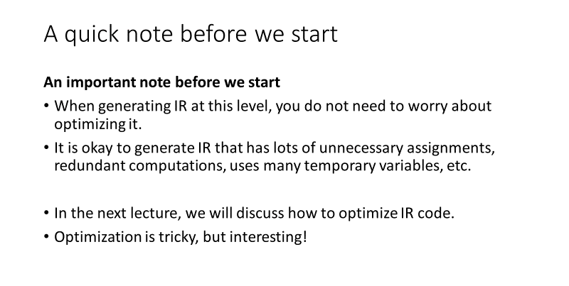
Remember what we said earlier
TAC code (not optimal but works!)
_t4 := 5
_t0 := _t4
_t5 := x
_t1 := _t5
_t2 := _t0 + _t1

Slide 45
Practice: TAC for booleans
Question 1: Following our idea for cgen(e1 + e2), how would you define a cgen() for Boolean operations, e.g. cgen(e1 <= e2)?
Remember that the CFG of the TAC languages allows for ==, < and || operations, but not <=!
Question 2: Using our cgen() functions from earlier, how would you encode in TAC the operation “(5 + x) <= 10”? Show your steps.

Slide 46
Practice: TAC for booleans
Question 1: Following our idea for cgen(e1 + e2), how would you define a cgen() for Boolean operations, e.g. cgen(e1 <= e2)?
Remember that the CFG of the TAC languages allows for ==, < and || operations, but not <=!
Question 2: Using our cgen() functions from earlier, how would you encode in TAC the operation “(5 + x) <= 10”? Show your steps.
Answer: to be shown on board.

Slide 47
TAC for control structures
Let us now assume that we have figured our TAC cgen() functions for all Boolean operations.
Question: How would I encode an if statement in TAC code?
if(x < y)
z = x;
else
z = y;
z = z*z;

Slide 48
TAC for control structures
Let us now assume that we have figured our TAC cgen() functions for all Boolean operations.
Question: How would I encode an if statement in TAC code?
if(x < y)
z = x;
else
z = y;
z = z*z;
What could cgen(if S1 S2 else S3) be, with S1, S2 and S3 being statements of some sort?

Slide 49
TAC for control structures
Let us now assume that we have figured our TAC cgen() functions for all Boolean operations.
Question: How would I encode an if statement in TAC code?
if(x < y)
z = x;
else
z = y;
z = z*z;
What could cgen(if S1 S2 else S3) be, with S1, S2 and S3 being statements of some sort?
Remember two things:
This if statement could be represented as a control-flow graph.

Slide 50
TAC for control structures
L0:
w = x < y
if w goto L1
jump L2
Let us now assume that we have figured our TAC cgen() functions for all Boolean operations.
Question: How would I encode an if statement in TAC code?
if(x < y)
z = x;
else
z = y;
z = z*z;
L1:
z = x
jump L3
L2:
z = y
jump L3
L3:
z = z*z

Slide 51
TAC for control structures
Let us now assume that we have figured our TAC cgen() functions for all Boolean operations.
Question: How would I encode an if statement in TAC code?
if(x < y)
z = x;
else
z = y;
z = z*z;
What could cgen(if S1 S2 else S3) be, with S1, S2 and S3 being statements of some sort?
Remember two things:
This if statement could be represented as a control-flow graph.
Our TAC grammar allows for
S → if id goto L
S → L:
S → jump L

Slide 52
TAC for control structures
cgen(if S1 S2 else S3) = {
Choose three new temporary t using our counter n. Increment n by 3;
Let _tn = cgen(S1);
Let _t(n+1) = cgen(S2); ?
Let _t(n+2) = cgen(S3); ?
…
}

Slide 53
TAC for control structures
We need a second counter k, which will keep track of the block indexes for defining some Lk block labels. Add it along with n.

Slide 54
TAC for control structures
TAC system counters: n, k.
cgen(if S1 S2 else S3) = {
Choose three new temporary t using our counter n. Increment n by 3;
Let _tn = cgen(S1);
Choose four new block labels Lk. Increment k by 4;
Emit(Lk:).
Emit(if _tn goto L(k+1)).
Emit(jump L(k+2)).
…
}

Slide 55
TAC for control structures
L0:
w = x < y
if w goto L1
jump L2
Let us now assume that we have figured our TAC cgen() functions for all Boolean operations.
Question: How would I encode an if statement in TAC code?
if(x < y)
z = x;
else
z = y;
z = z*z;
L1:
z = x
jump L3
L2:
z = y
jump L3
L3:
z = z*z

Slide 56
TAC for control structures
TAC system counters: n, k.
cgen(if S1 S2 else S3) = {
Choose three new temporary t using our counter n. Increment n by 3;
Let _tn = cgen(S1);
Choose four new block labels Lk. Increment k by 4;
Emit(Lk:). Emit(if _tn goto L(k+1)). Emit(jump L(k+2)).
Emit(L(k+1):).
Let _t(n+1) = cgen(S2);
Emit(jump L(k+3)).
}

Slide 57
TAC for control structures
L0:
w = x < y
if w goto L1
jump L2
Let us now assume that we have figured our TAC cgen() functions for all Boolean operations.
Question: How would I encode an if statement in TAC code?
if(x < y)
z = x;
else
z = y;
z = z*z;
L1:
z = x
jump L3
L2:
z = y
jump L3
L3:
z = z*z

Slide 58
TAC for control structures
TAC system counters: n, k.
cgen(if S1 S2 else S3) = {
Choose three new temporary t using our counter n. Increment n by 3;
Let _tn = cgen(S1);
Choose four new block labels Lk. Increment k by 4;
Emit(Lk:). Emit(if _tn goto L(k+1)). Emit(jump L(k+2)).
Emit(L(k+1):). Let _t(n+1) = cgen(S2); Emit(jump L(k+3)).
Emit(L(k+2):). Let _t(n+2) = cgen(S3); Emit(jump L(k+3)).
}

Slide 59
TAC for control structures
L0:
w = x < y
if w goto L1
jump L2
Let us now assume that we have figured our TAC cgen() functions for all Boolean operations.
Question: How would I encode an if statement in TAC code?
if(x < y)
z = x;
else
z = y;
z = z*z;
L1:
z = x
jump L3
L2:
z = y
jump L3
L3:
z = z*z

Slide 60
TAC for control structures
TAC system counters: n, k.
cgen(if S1 S2 else S3) = {
Choose three new temporary t using our counter n. Increment n by 3;
Let _tn = cgen(S1);
Choose four new block labels Lk. Increment k by 4;
Emit(Lk:). Emit(if _tn goto L(k+1)). Emit(jump L(k+2)).
Emit(L(k+1):). Let _t(n+1) = cgen(S2); Emit(jump L(k+3)).
Emit(L(k+2):). Let _t(n+2) = cgen(S3); Emit(jump L(k+3)).
Return?
}

Slide 61
TAC for control structures
TAC system counters: n, k.
cgen(if S1 S2 else S3) = {
Choose three new temporary t using our counter n. Increment n by 3;
Let _tn = cgen(S1);
Choose four new block labels Lk. Increment k by 4;
Emit(Lk:). Emit(if _tn goto L(k+1)). Emit(jump L(k+2)).
Emit(L(k+1):). Let _t(n+1) = cgen(S2); Emit(jump L(k+3)).
Emit(L(k+2):). Let _t(n+2) = cgen(S3); Emit(jump L(k+3)).
Return?
}

Slide 62
TAC for control structures
TAC system counters: n, k.
cgen(if S1 S2 else S3) = {
Choose three new temporary t using our counter n. Increment n by 3;
Let _tn = cgen(S1);
Choose four new block labels Lk. Increment k by 4;
Emit(Lk:). Emit(if _tn goto L(k+1)). Emit(jump L(k+2)).
Emit(L(k+1):). Let _t(n+1) = cgen(S2); Emit(jump L(k+3)).
Emit(L(k+2):). Let _t(n+2) = cgen(S3); Emit(jump L(k+3)).
Emit(L(k+3):).
}

Slide 63
TAC for if statement
Consider the code below. What will be the TAC for this code?
if(x < y)
z = x;
else
z = y;
z = z*z;

Slide 64
TAC for if statement
Consider the code below. What will be the TAC for this code?
if(x < y)
z = x;
else
z = y;
z = z*z;
We have to run two cgen() operation in sequence to get the full TAC code.
cgen(if x<y z=x else z=y)
cgen(z = z*z)

Slide 65
TAC for if statement
TAC system counters: n = 0, k = 0.
cgen(if S1 S2 else S3) = {
Choose three new temporary t using our counter n. Increment n by 3;
Let _tn = cgen(S1);
Choose four new block labels Lk. Increment k by 4;
Emit(Lk:). Emit(if _tn goto L(k+1)). Emit(jump L(k+2)).
Emit(L(k+1):). Let _t(n+1) = cgen(S2); Emit(jump L(k+3)).
Emit(L(k+2):). Let _t(n+2) = cgen(S3); Emit(jump L(k+3)).
Emit(L(k+3):).
}

Slide 66
TAC for if statement
TAC system counters: n = 0, k = 0.
cgen(if x<y z=x else x=y) = {
Choose three new temporary t using our counter n. Increment n by 3;
Let _tn = cgen(x<y);
Choose four new block labels Lk. Increment k by 4;
Emit(Lk:). Emit(if _tn goto L(k+1)). Emit(jump L(k+2)).
Emit(L(k+1):). Let _t(n+1) = cgen(z=x); Emit(jump L(k+3)).
Emit(L(k+2):). Let _t(n+2) = cgen(x=y); Emit(jump L(k+3)).
Emit(L(k+3):).
}

Slide 67
TAC for if statement
TAC system counters: n = 3, k = 0.
cgen(if x<y z=x else x=y) = {
Choose three new temporary t using our counter n. Increment n by 3;
Let _t0 = cgen(x<y);
Choose four new block labels Lk. Increment k by 4;
Emit(Lk:). Emit(if _t0 goto L(k+1)). Emit(jump L(k+2)).
Emit(L(k+1):). Let _t1 = cgen(z=x); Emit(jump L(k+3)).
Emit(L(k+2):). Let _t2 = cgen(x=y); Emit(jump L(k+3)).
Emit(L(k+3):).
}

Slide 68
TAC for if statement
TAC system counters: n = 3, k = 4.
cgen(if x<y z=x else x=y) = {
Choose three new temporary t using our counter n. Increment n by 3;
Let _t0 = cgen(x<y);
Choose four new block labels Lk. Increment k by 4;
Emit(L0:). Emit(if _t0 goto L1). Emit(jump L2).
Emit(L1:). Let _t1 = cgen(z=x); Emit(jump L3).
Emit(L2:). Let _t2 = cgen(x=y); Emit(jump L3).
Emit(L3:).
}

Slide 69
TAC for if statement
TAC system counters: n = 3, k = 4.
cgen(if x<y z=x else x=y) = {
Choose three new temporary t using our counter n. Increment n by 3;
Let _t0 = cgen(x<y);
Choose four new block labels Lk. Increment k by 4;
Emit(L0:). Emit(if _t0 goto L1). Emit(jump L2).
Emit(L1:). Let _t1 = cgen(z=x); Emit(jump L3).
Emit(L2:). Let _t2 = cgen(x=y); Emit(jump L3).
Emit(L3:).
}
TAC code

Slide 70
TAC for if statement
TAC system counters: n = 3, k = 4.
cgen(e1 < e2) = {
Choose three new temporary t using our counter n (we shall name them as _tn, _t(n+1), _t(n+2));
Increment n by 3;
Let _tn = cgen(e1);
Let _t(n+1) = cgen(e2);
Emit (_t(n+2) = _tn + _t(n+1));
Return _t(n+2);
}
TAC code

Slide 71
TAC for if statement
TAC system counters: n = 6, k = 4.
cgen(x < y) = {
Choose three new temporary t using our counter n (we shall name them as _t4, _t5, _t6);
Increment n by 3;
Let _t4 = cgen(x);
Let _t5 = cgen(y);
Emit (_t6 = _t4 < _t5);
Return _t6;
}
TAC code

Slide 72
TAC for if statement
TAC system counters: n = 7, k = 4.
cgen(x < y) = {
Choose three new temporary t using our counter n (we shall name them as _t4, _t5, _t6);
Increment n by 3;
Let _t4 = cgen(x);
Let _t5 = cgen(y);
Emit (_t6 = _t4 < _t5);
Return _t6;
}
TAC code
_t7 := x
_t4 := _t7

Slide 73
TAC for if statement
TAC system counters: n = 8, k = 4.
cgen(x < y) = {
Choose three new temporary t using our counter n (we shall name them as _t4, _t5, _t6);
Increment n by 3;
Let _t4 = cgen(x);
Let _t5 = cgen(y);
Emit (_t6 = _t4 < _t5);
Return _t6;
}
TAC code
_t7 := x
_t4 := _t7
_t8 := y
_t5 := _t8

Slide 74
TAC for if statement
TAC system counters: n = 8, k = 4.
cgen(x < y) = {
Choose three new temporary t using our counter n (we shall name them as _t4, _t5, _t6);
Increment n by 3;
Let _t4 = cgen(x);
Let _t5 = cgen(y);
Emit (_t6 = _t4 < _t5);
Return _t6;
}
TAC code
_t7 := x
_t4 := _t7
_t8 := y
_t5 := _t8
_t6 := _t4 < _t5

Slide 75
TAC for if statement
TAC system counters: n = 3, k = 4.
cgen(if x<y z=x else x=y) = {
Choose three new temporary t using our counter n. Increment n by 3;
Let _t0 = cgen(x<y);
Choose four new block labels Lk. Increment k by 4;
Emit(L0:). Emit(if _t0 goto L1). Emit(jump L2).
Emit(L1:). Let _t1 = cgen(z=x); Emit(jump L3).
Emit(L2:). Let _t2 = cgen(x=y); Emit(jump L3).
Emit(L3:).
}
TAC code
_t7 := x
_t4 := _t7
_t8 := y
_t5 := _t8
_t6 := _t4 < _t5
_t0 := _t6
L0:

Slide 76
TAC for if statement
TAC system counters: n = 3, k = 4.
cgen(if x<y z=x else x=y) = {
Choose three new temporary t using our counter n. Increment n by 3;
Choose four new block labels Lk. Increment k by 4;
Emit(L0:). Let _t0 = cgen(x<y);
Emit(if _t0 goto L1). Emit(jump L2).
Emit(L1:). Let _t1 = cgen(z=x); Emit(jump L3).
Emit(L2:). Let _t2 = cgen(x=y); Emit(jump L3).
Emit(L3:).
}
TAC code
L0:
_t7 := x
_t4 := _t7
_t8 := y
_t5 := _t8
_t6 := _t4 < _t5
_t0 := _t6

Slide 77
Revised TAC for control structures
TAC system counters: n, k.
cgen(if S1 S2 else S3) = {
Choose three new temporary t using our counter n. Increment n by 3;
Choose four new block labels Lk. Increment k by 4;
Emit(Lk:). Let _tn = cgen(S1);
Emit(if _tn goto L(k+1)). Emit(jump L(k+2)).
Emit(L(k+1):). Let _t(n+1) = cgen(S2); Emit(jump L(k+3)).
Emit(L(k+2):). Let _t(n+2) = cgen(S3); Emit(jump L(k+3)).
Emit(L(k+3):).
}

Slide 78
TAC for if statement
TAC system counters: n = 8, k = 4.
cgen(if x<y z=x else x=y) = {
Choose three new temporary t using our counter n. Increment n by 3;
Choose four new block labels Lk. Increment k by 4;
Emit(L0:). Let _t0 = cgen(x<y);
Emit(if _t0 goto L1). Emit(jump L2).
Emit(L1:). Let _t1 = cgen(z=x); Emit(jump L3).
Emit(L2:). Let _t2 = cgen(x=y); Emit(jump L3).
Emit(L3:).
}
TAC code
L0:
_t7 := x
_t4 := _t7
_t8 := y
_t5 := _t8
_t6 := _t4 < _t5
_t0 := _t6
if _t0 goto L1
jump L2

Slide 79
TAC for if statement
TAC code
L0:
_t7 := x
_t4 := _t7
_t8 := y
_t5 := _t8
_t6 := _t4 < _t5
_t0 := _t6
if _t0 goto L1
jump L2
L1:
z := x
_t1:= null
jump L3
TAC system counters: n = 8, k = 4.
cgen(if x<y z=x else x=y) = {
Choose three new temporary t using our counter n. Increment n by 3;
Choose four new block labels Lk. Increment k by 4;
Emit(L0:). Let _t0 = cgen(x<y);
Emit(if _t0 goto L1). Emit(jump L2).
Emit(L1:). Let _t1 = cgen(z=x); Emit(jump L3).
Emit(L2:). Let _t2 = cgen(x=y); Emit(jump L3).
Emit(L3:).
}

Slide 80
TAC for if statement
TAC code
L0:
_t7 := x
_t4 := _t7
_t8 := y
_t5 := _t8
_t6 := _t4 < _t5
_t0 := _t6
if _t0 goto L1
jump L2
L1:
z := x
_t1 := null
jump L3
L2:
x := y
_t2 := null
jump L3
TAC system counters: n = 8, k = 4.
cgen(if x<y z=x else x=y) = {
Choose three new temporary t using our counter n. Increment n by 3;
Choose four new block labels Lk. Increment k by 4;
Emit(L0:). Let _t0 = cgen(x<y);
Emit(if _t0 goto L1). Emit(jump L2).
Emit(L1:). Let _t1 = cgen(z=x); Emit(jump L3).
Emit(L2:). Let _t2 = cgen(x=y); Emit(jump L3).
Emit(L3:).
}

Slide 81
TAC for if statement
TAC code
L0:
_t7 := x
_t4 := _t7
_t8 := y
_t5 := _t8
_t6 := _t4 < _t5
_t0 := _t6
if _t0 goto L1
jump L2
L1:
z := x
_t1 := null
jump L3
L2:
x := y
_t2 := null
jump L3
L3:
TAC system counters: n = 8, k = 4.
cgen(if x<y z=x else x=y) = {
Choose three new temporary t using our counter n. Increment n by 3;
Choose four new block labels Lk. Increment k by 4;
Emit(L0:). Let _t0 = cgen(x<y);
Emit(if _t0 goto L1). Emit(jump L2).
Emit(L1:). Let _t1 = cgen(z=x); Emit(jump L3).
Emit(L2:). Let _t2 = cgen(x=y); Emit(jump L3).
Emit(L3:).
}

Slide 82
TAC for if statement
TAC system counters: n = 11, k = 4.
cgen(z = z * z) = {
Choose three new temporary t using our counter n (we shall name them as _t8, _t9, _t10);
Increment n by 3;
Let _t8 = cgen(z);
Let _t9 = cgen(z);
Emit (_t10 = _t8 * _t9);
Emit (z = _t10)
Return null;
}
We have to run two cgen() operation in sequence to get the full TAC code.
cgen(if x<y z=x else x=y)
cgen(z = z*z)
Note: this second operation needs not to be decomposed but could simply combine several concepts from previous cgen() functions together.

Slide 83
TAC for if statement
TAC code
L0:
_t7 := x
_t4 := _t7
_t8 := y
_t5 := _t8
_t6 := _t4 < _t5
_t0 := _t6
if _t0 goto L1
jump L2
L1:
z := x
_t1 := null
jump L3
L2:
x := y
_t2 := null
jump L3
L3:
_t8 := z
_t9 := z
_t10 = z*z
z := _t10
TAC system counters: n = 11, k = 4.
cgen(z = z * z) = {
Choose three new temporary t using our counter n (we shall name them as _t8, _t9, _t10);
Increment n by 3;
Let _t8 = cgen(z);
Let _t9 = cgen(z);
Emit (_t10 = _t8 * _t9);
Emit (z = _t10)
Return null;
}

Slide 84
TAC for if statement
TAC code
L0:
_t7 := x
_t4 := _t7
_t8 := y
_t5 := _t8
_t6 := _t4 < _t5
_t0 := _t6
if _t0 goto L1
jump L2
L1:
z := x
_t1 := null
jump L3
L2:
x := y
_t2 := null
jump L3
L3:
_t8 := z
_t9 := z
_t10 = z*z
z := _t10
Consider the code below. What will be the TAC for this code?
if(x < y)
z = x;
else
z = y;
z = z*z;

Slide 85
TAC for if statement
TAC code
L0:
_t7 := x
_t4 := _t7
_t8 := y
_t5 := _t8
_t6 := _t4 < _t5
_t0 := _t6
if _t0 goto L1
jump L2
L1:
z := x
_t1 := null
jump L3
L2:
x := y
_t2 := null
jump L3
L3:
_t8 := z
_t9 := z
_t10 = z*z
z := _t10
Not exactly optimal, but again, we do not care!
A different part of the compiler will be in charge of optimizing this TAC code later on!

Slide 86
TAC for function calls
Writing TAC becomes a bit tricky when accounting for function calls.
For instance, consider the code below.
void f(int z) {
int x;
x = z*z
return x;
}
void main(){
f(11);
int y = f(8);
}

Slide 87
TAC for function calls
TAC code
L0:
_t0 := z
_t1 := _t0*_t0
Return _t1? (not allowed in TAC)
L1:
_t2 := 11
Goto L0 with _t2 as z?
Nothing to catch the return of that function?
_t3 := 8
Goto L0 with _t3 as z?
Something to catch the return of that function?
The code could be transformed into a TAC using our cgen(), as shown on the right.
void f(int z) {
int x;
x = z*z
return x;
}
void main(){
f(11);
int y = f(8);
}

Slide 88
Handling function calls with a stack
What is missing here?
Need to find a way to transfer parameters (x1, …, xn) from current scope (e.g. the main() one) to a function scope (e.g. function f called in main()).
We need to know where the TAC code for f() is.
In case of a return in f(), need a way to retrieve parameters from the function scope and bring them back into the enclosing scope.
Should be done in a way to prevent clashes
Should cover for null returns
Should cover for returns not being caught, etc.

Slide 89
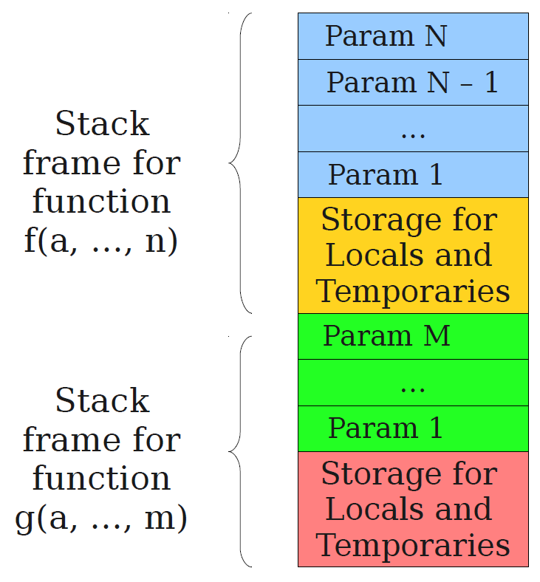
Handling function calls with a stack
Idea: Use a stack to represent the scope of a given function.
Scope will decompose in two parts
The parameters passed to this function (could be none).
The temporary parameters (_tn) used by this function during the computation.
In this second case, we need to know the number of _tn used by the function f!

Slide 90
Handling function calls with a stack
Idea: Use a stack to represent the scope of a given function.
Whenever a function g() is called withing the scope of function f(), we will:
Push some parameters from the scope of f() into the parameters stack of g().
Allocate space for the temporary variables used by g().

Slide 91
Handling function calls with a stack
Idea: Use a stack to represent the scope of a given function.
Upon completing g(), we will
Pop some values from the temporary variables and add them to the temporaries of f().
Or not (if no return specified).

Slide 92
Handling function calls with a stack
TAC can be used to handle function calls in a similar way to how it handles other code constructs.
When a function call is encountered in the code, the TAC generator will typically create a new label for the function and generate code to push any arguments onto the stack.
We denote this operation “push _tn” in TAC.

Slide 93
Handling function calls with a stack
TAC can be used to handle function calls in a similar way to how it handles other code constructs.
When a function call is encountered in the code, the TAC generator will typically create a new label for the function and generate code to push any arguments onto the stack.
In addition, the TAC needs to allocate space into the stack for all the temporary variables that function f() will require.
It does so, with a command called “BeginFunc N”, which allocates N bytes in the stack to store data.
In general memory entries are 32 bytes, so N is expected to be a multiple of 4 (e.g. N = 16 → 4 temporary variables).

Slide 94
Handling function calls with a stack
TAC can be used to handle function calls in a similar way to how it handles other code constructs.
When the function returns, the TAC generator will generate code to pop any return values off the stack and store them in the appropriate variables.
It is done in two steps.
The first step, reclaims the parameters space we opened with “push” operations, and this is done with a TAC command called “EndFunc”.

Slide 95
Handling function calls with a stack
TAC can be used to handle function calls in a similar way to how it handles other code constructs.
When the function returns, the TAC generator will generate code to pop any return values off the stack and store them in the appropriate variables.
It is done in two steps.
The second step, retrieves values that must be returned (and clears the rest of the temporary parameters in the process).
This is done with a “pop N” operations, which allows the callee f() to retrieve parameters N bytes of data from the temporary variables in the scope of g().
Basically implementing a return.

Slide 96
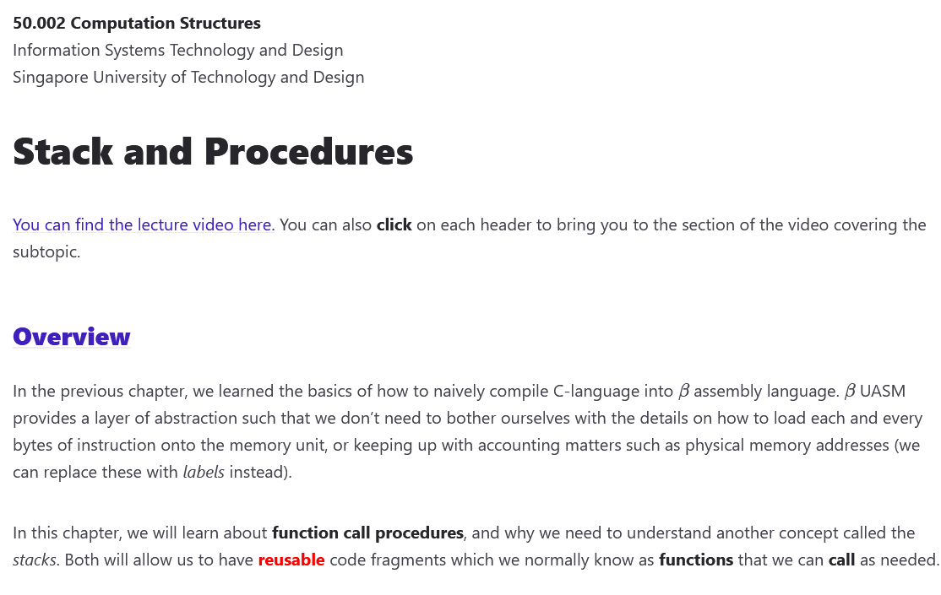
A blast from the past!
In a sense, what we are doing here is very similar to the way we handled Stacks and Procedures in 50.002 Computation Structures!
Need a refresher? https://natalieagus.github.io/50002/notes/stackandprocedures

Slide 97
TAC for function calls
TAC code
L0:
BeginFunc 8
_t0 := z
_t1 := _t0*_t0
EndFunc
L1:
BeginFunc 12
_t2 := 11
Push _t2
LCall L0
Pop 4
_t3 := 8
Push _t3
LCall L0
y := Pop 4
EndFunc
Using previous concepts, we have the TAC code for the function below.
void f(int z) {
int x;
x = z*z
return x;
}
void main(){
f(11);
int y = f(8);
}

Slide 98
Program counter, Frame pointers, Global variables, etc.
In general, TAC does not specify where variables and temporaries are stored in the stack. It might require to bring in concepts from Stacks and Procedures, such as:
Frame Pointer/Base pointer: A pointer points to the base of the current function activation record on the stack.
The activation record typically includes the function's local variables, any temporary values or registers, and other metadata that is needed to execute the function.

Slide 99
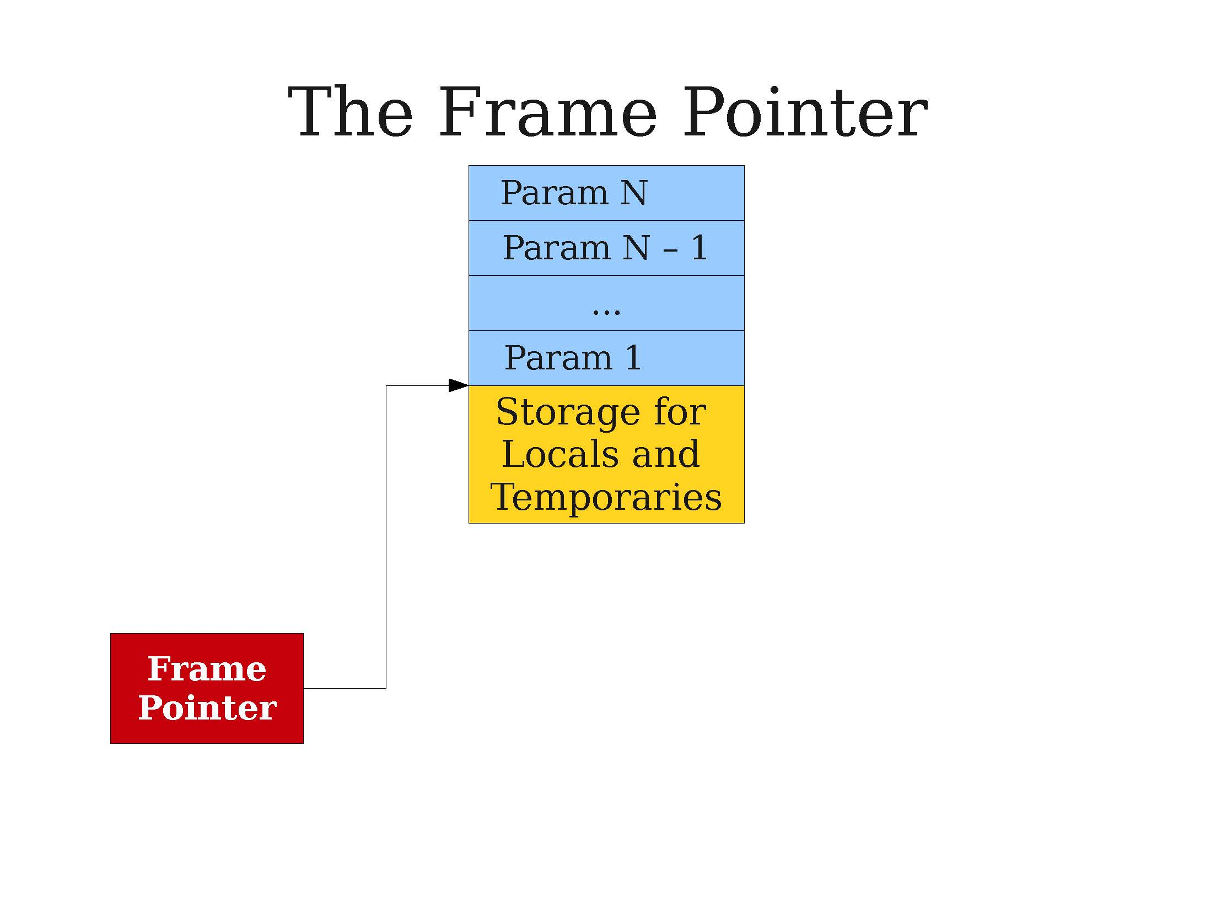
Using a frame pointer

Slide 100
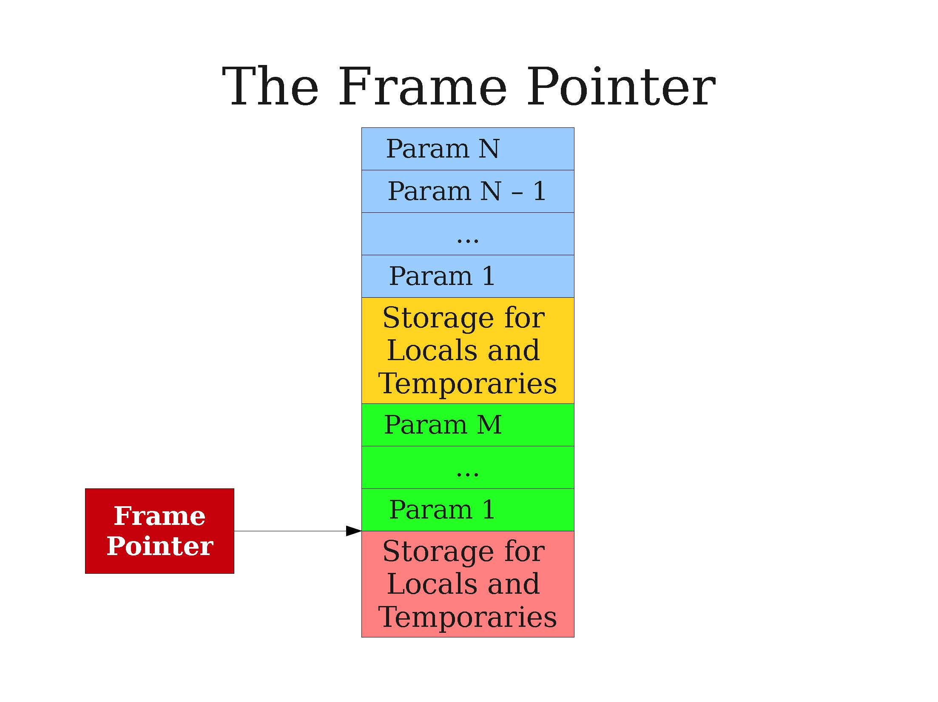
Using a frame pointer

Slide 101
Using a frame pointer

Slide 102
Program counter, Frame pointers, Global variables, etc.
In general, TAC does not specify where variables and temporaries are stored in the stack. It might require to bring in concepts from Stacks and Procedures, such as:
Program Counter/Pointer: Internally, the processor has a special register called the program counter/pointer (PC) that stores the address of the next instruction to execute.
Whenever a function returns it shall restore the PC to the correct value, so that the calling function resumes its execution where it left off.
We often store this address in our stack, along with function parameters and temporaries, in a location called the Return Address.

Slide 103
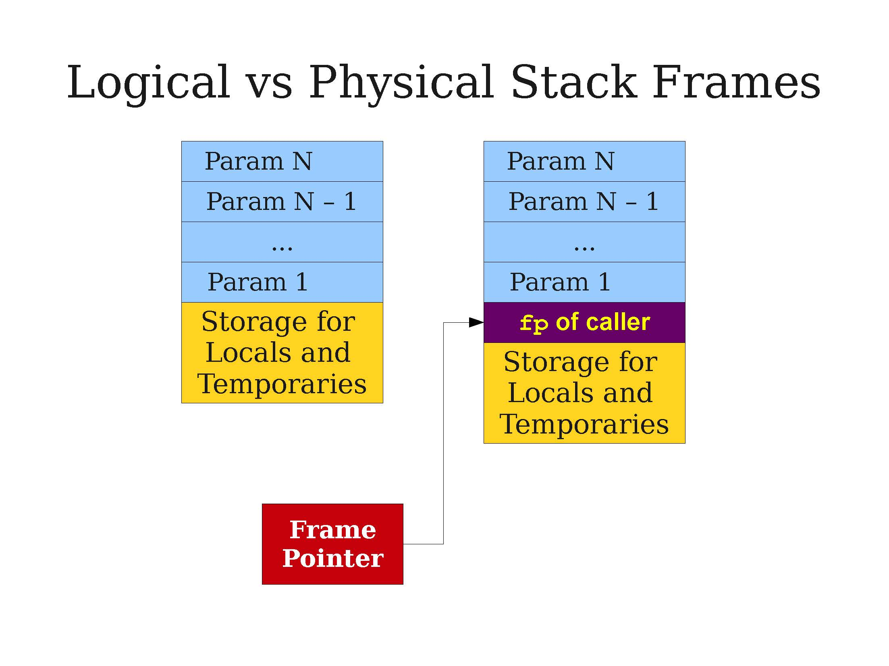
Using a caller addresses and return addresses

Slide 104
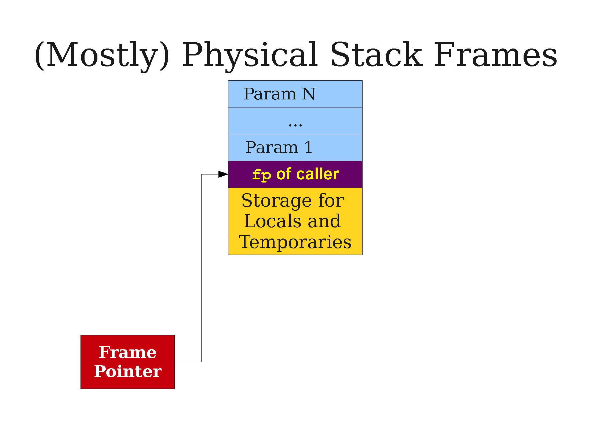
Using a caller addresses and return addresses

Slide 105
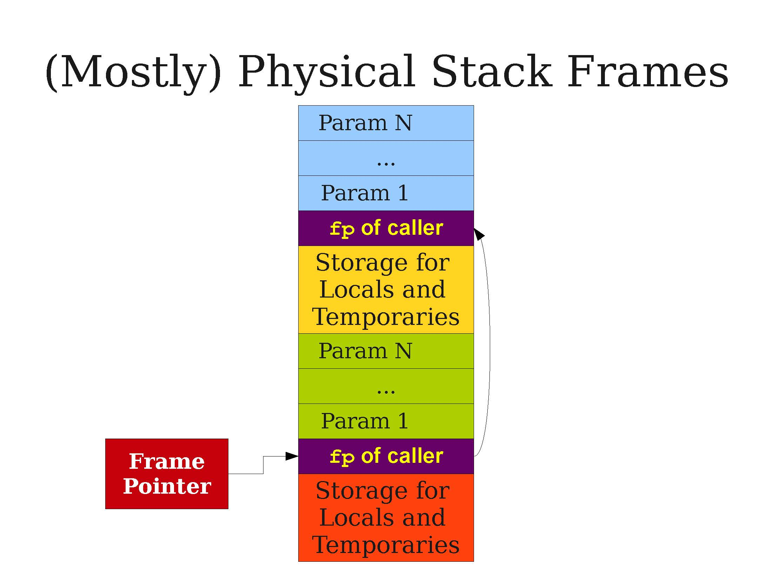
Using a caller addresses and return addresses

Slide 106
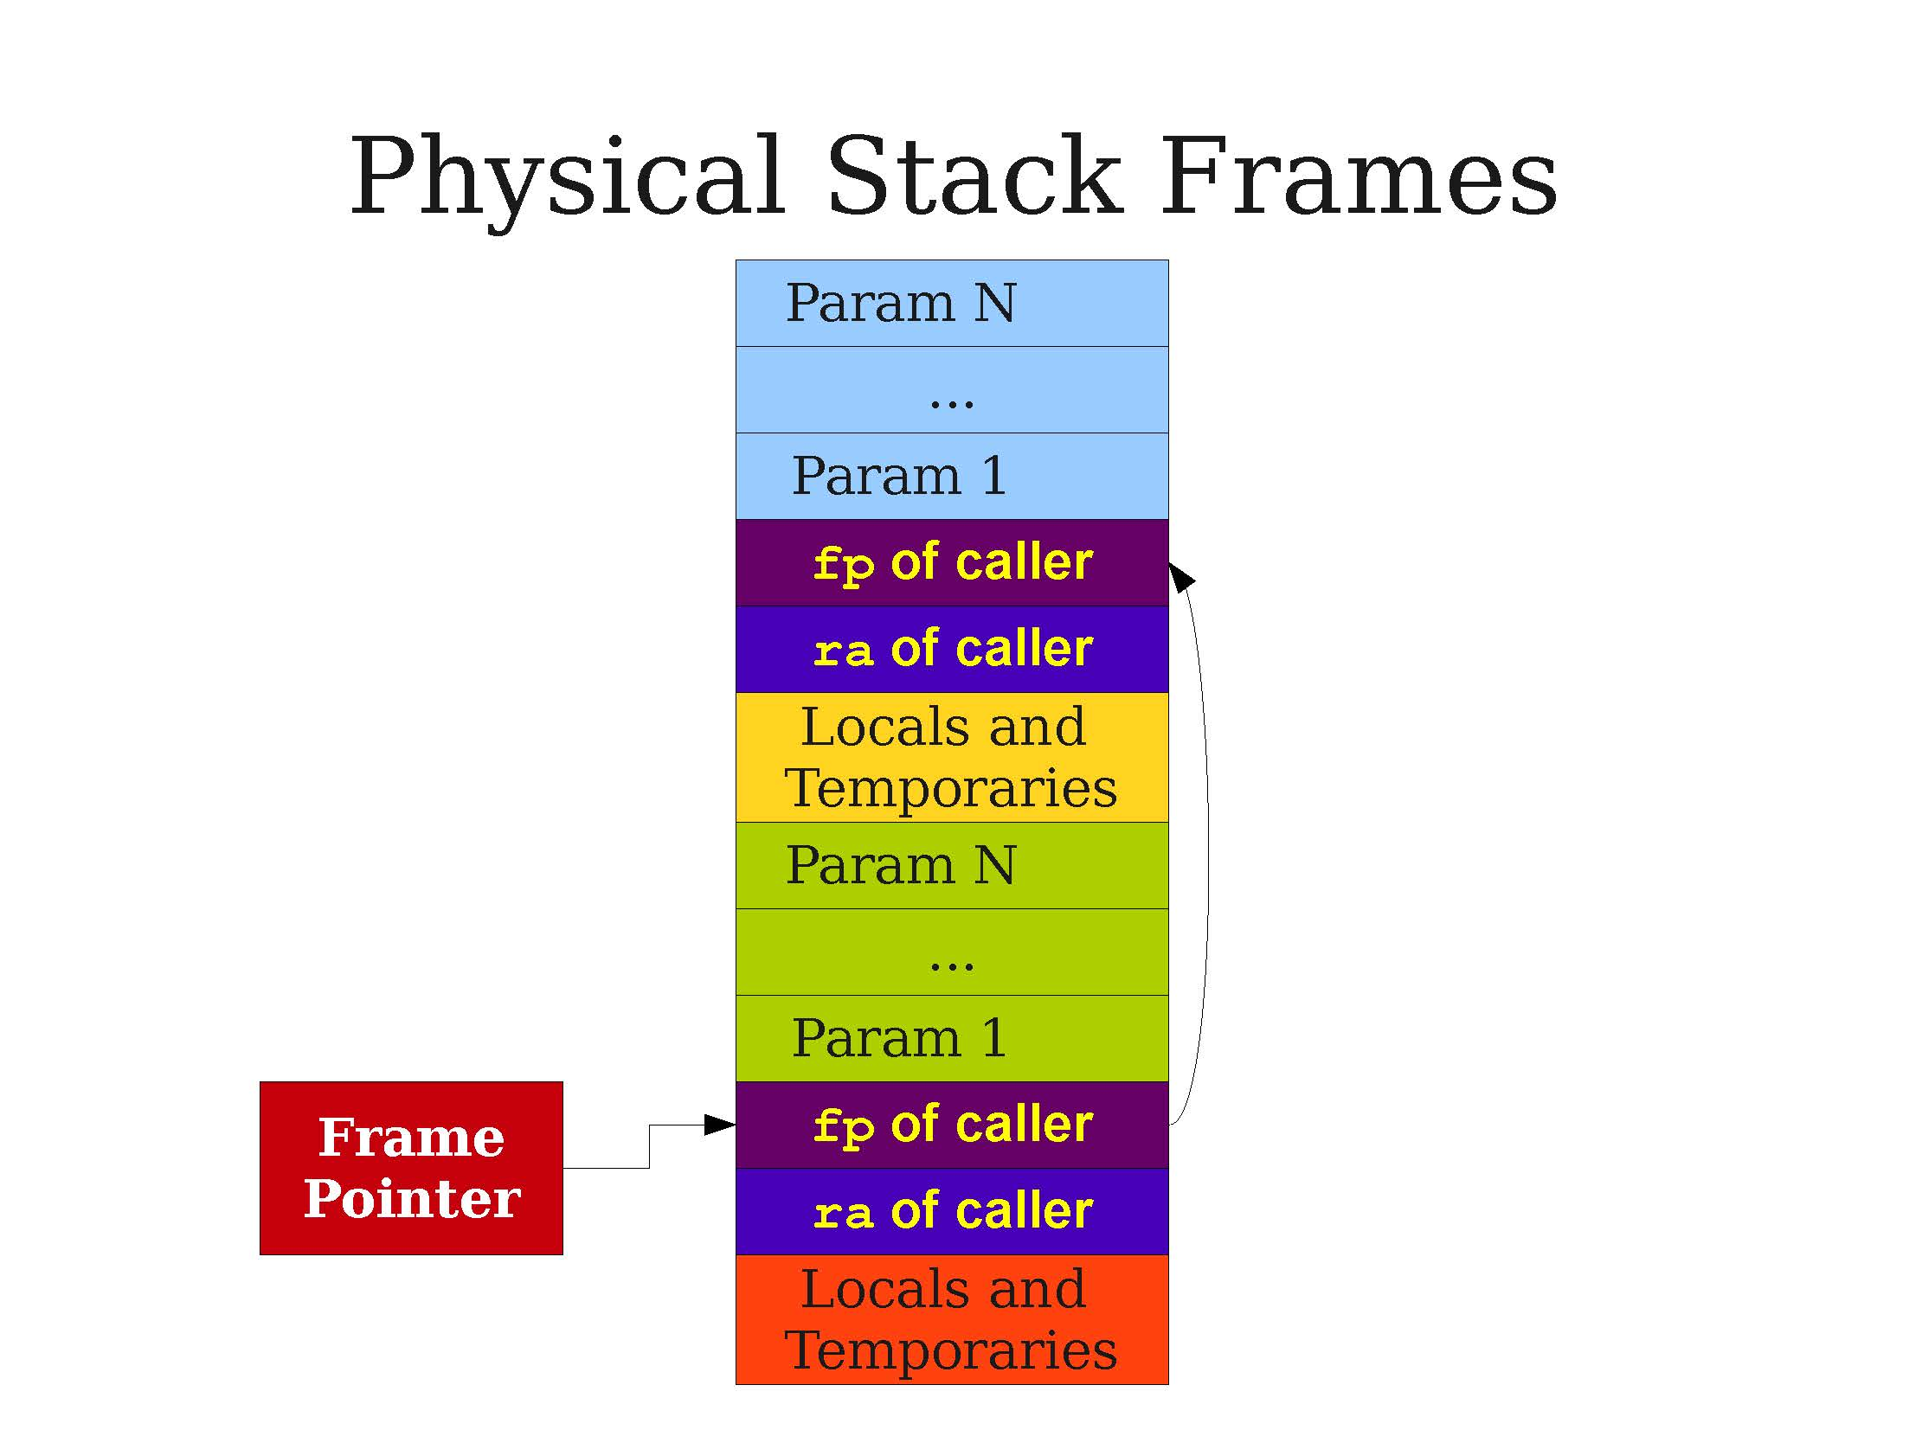
Using a caller addresses and return addresses

Slide 107
Program counter, Frame pointers, Global variables, etc.
In general, TAC does not specify where variables and temporaries are stored in the stack. It might require to bring in concepts from Stacks and Procedures, such as:
Global Pointer: Some compilers will typically allow for LEGB scope searching, which means there should be a register for global variables that the TAC can use for computation.
A bit more advanced (and definitely out of scope), but often stored on top of the previous stack.
Adding entries to global scope makes the stack go up.
Opening function scopes makes the stack go down.

Slide 108
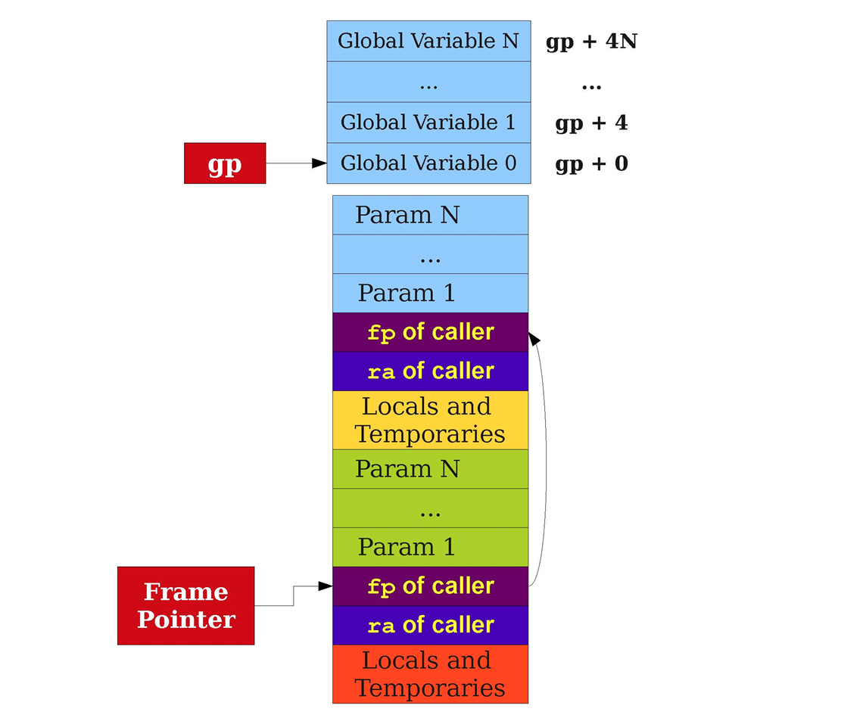

Slide 109
Program counter, Frame pointers, Global variables, etc.
In general, TAC does not specify where variables and temporaries are stored in the stack. It might require to bring in concepts from Stacks and Procedures, such as:
Frame Pointer/Base Pointer,
Program Counter/Pointer, and Return Addresses
Global Pointer,
Etc.
Again, something already discussed in Stacks and Procedures, 50.002 Computation Structures! https://natalieagus.github.io/50002/notes/stackandprocedures
Out of scope for 50.051, but not 50.002!

Slide 110
A quick word on TAC for objects
Encoding custom objects in TAC can prove to be very challenging.
Need to allocate the right amount of space for attributes,
Correctly link all methods and encode them correctly,
Account for possible inheritance and overloading,
Etc.
Intuitively, we understand that it can be done with a vtable of some sort
Definitely out-of-scope!

Slide 111
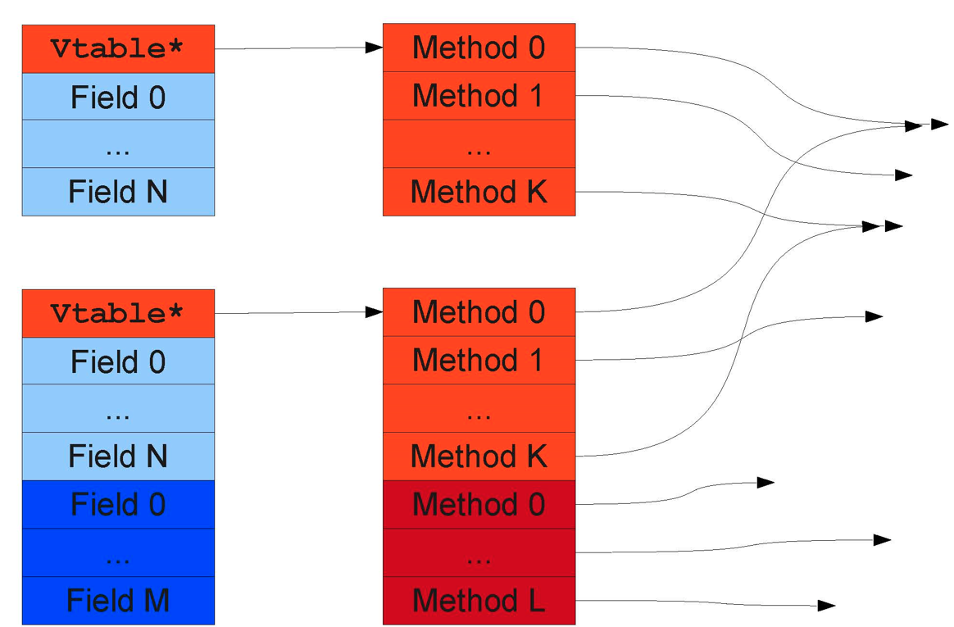
A quick word on TAC for objects

Slide 112
Conclusion
We understand how TAC is done and what intricacies might be required…
Introduction to TAC.
TAC for simple expressions.
TAC for functions and function calls.
TAC for objects.
TAC for arrays.
Generating TAC.
A few low-level details.

Slide 113
The middle-end of a compiler
TAC code
L0:
_t7 := x
_t4 := _t7
_t8 := y
_t5 := _t8
_t6 := _t4 < _t5
_t0 := _t6
if _t0 goto L1
jump L2
L1:
z := x
_t1 := null
jump L3
L2:
x := y
_t2 := null
jump L3
L3:
_t8 := z
_t9 := z
_t10 = z*z
z := _t10
Our next step after Intermediate code generation is then Code optimization!
(Because, yes, our TAC codes at the moment are functional but not exactly looking great…)

Slide 114
Quiz time!
Which of the following best describes the structure of a three-address code?
Three operands and one operator
Two operands and two operators
One operand and three operators
Three operands and no operator

Slide 115
Quiz time!
Which of the following best describes the structure of a three-address code?
Three operands and one operator
Two operands and two operators
One operand and three operators
Three operands and no operator

Slide 116
Quiz time!
In the context of three-address code, what is the purpose of the "basic block" concept?
To define a sequence of code with a single entry and exit point
To divide code into smaller, manageable units for optimization
To handle loops and conditional statements correctly
All of the above
None of the above

Slide 117
Quiz time!
In the context of three-address code, what is the purpose of the "basic block" concept?
To define a sequence of code with a single entry and exit point
To divide code into smaller, manageable units for optimization
To handle loops and conditional statements correctly
All of the above (more on B in the next lecture!)
None of the above

Slide 118
Quiz time!
Which of the following is NOT a common operation in three-address code?
Arithmetic operations
Conditional jumps
Function calls
Dynamic memory allocation

Slide 119
Quiz time!
Which of the following is NOT a common operation in three-address code?
Arithmetic operations
Conditional jumps
Function calls
Dynamic memory allocation (that is something the backend will have to resolve later on during register allocation!)

Slide 120
Practice 2: a while statement TAC
Consider the code below.
x = 1
y = 3
while(x < y):
x = x + 2;
z = x;
z = z*z;
Question #1: How would you write the cgen() for the while statement?
You may look for inspiration by looking at the if() statement one.
Question #2: What would the TAC code be then?

Slide 121
Practice 3: a while statement TAC
Question #1: How would you write the cgen() function for the for loop statement in C?
You may look for inspiration by looking at the if() statement one and the while() statement in the previous activity.
Question #2 (somewhat difficult): How would you then agreement it to account for a possible break keyword?

Slide 122
Practice 4: a switch statement TAC
Question (somewhat tedious): How would you write the cgen() function for the switch statement in C?

